Slide 1
New York Education System’S SHSAT TEst
By: Elijah Fuller

Slide 2
The DataSet
The dataset can be found on Kaggle https://www.kaggle.com/passnyc/data-science-for-good#2016%20School%20Explorer.csv and was provided by PASSNYC.
The dataset included 1272 schools in the New York City area.
The test scores are from a test called SHSAT
The school dataset provider's definition for rigorous instruction is how well the students were engaged during the curriculum.

Slide 3
More About the Dataset
The shape is 1272 rows (schools) and 161 columns
dataset is to determine between which schools were better
There were 3 features that had nearly no data in the columns
Adjusted Grade – 1270/1272
New? – 1243/1272
Other Location in LCGMS – 1271/1272

Slide 4
What is the SHSAT? Specialized high School Admissions Test
8 New York specialized schools require this test for entrance
This test is given to students in the eighth and ninth grades
The test assesses English and math skills of the student
Students are ranked and assigned to a school based on test ranking

Slide 5
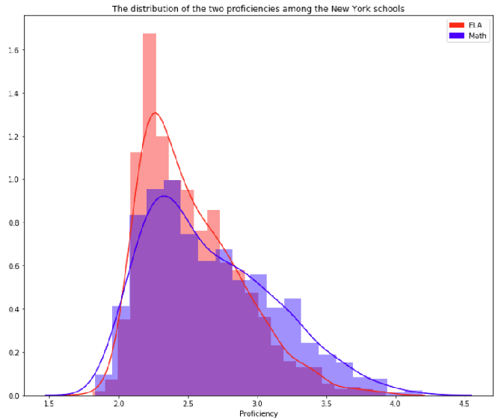
ELA vs Math Proficiency

Slide 6
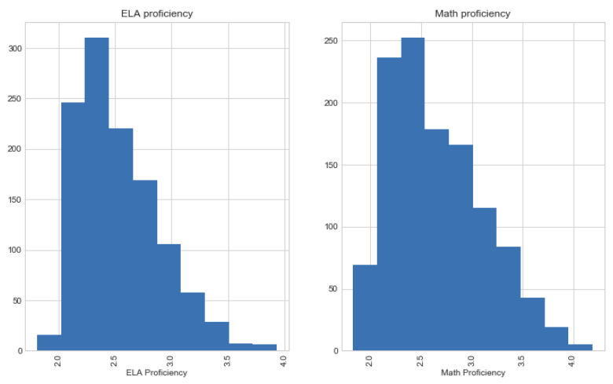
Full counts of both proficiencies

Slide 7
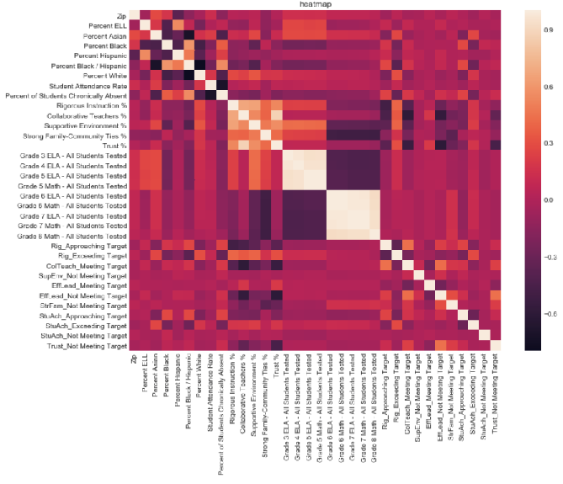
HeatMap to show correlation between features

Slide 8
My Feature selection Process
Dropped irrelevant features to lower the number of features to 56 from 161
Tried out two forms of feature selection: PCA and manually removal
Dropped poor performers based on Random Forest feature importance to 34

Slide 9
PCA Principal Component Analysis
Reduces the complexity by reducing the number of variables to a smaller set of components
Reduces the dimensionality
Extracts information while removing the noise
Simplifies the dataset

Slide 10
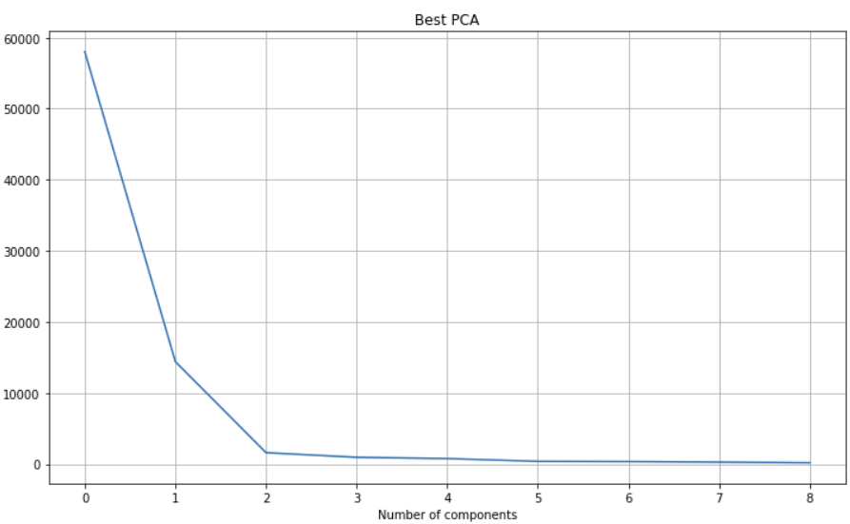
PCA Feature selection

Slide 11
Model Tuning
All models were tuned using gridsearchCV
gridsearchCV attempts the parameters given model to find the best parameters
used both PCA and my manually adjusted feature set for each model
tuned the models individually for feature set against ELA and math proficiency
used cross_val_score to split the data into 5 groups to test for overfitting

Slide 12
KNN
classifies new datapoints based on similarity of previous points.
has a relatively high accuracy while being extremely simple
can be used for classification or regression
stores the entire training data set
sensitive to irrelevant features and the scale of data

Slide 13
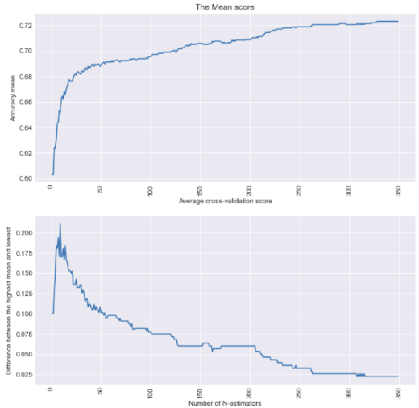
KNN Tuning graph

Slide 14
KNN
Test Subject | Parameters | Accuracy (Math) | Overfitting (Math
Math | n_neighbors = 330, weights ='distance’ | 73 | +/-.3%
ELA | n_neighbors = 30, weights ='distance' | 88.62% | +/-2%

Slide 15
Logistic Regression
Logistic Regression used to describe data and to explain the relationship between one dependent binary variable and one or more independent variables
simple and efficient
low variance
does not work well with larger numbers of categorical features

Slide 16
Logistic Regression
Test Subject | Parameters | Accuracy (Math) | Overfitting (Math
Math | C= 1.7000000000000006 | 84% | +/-8%
ELA | C = 0.002 | 91.4% | +/-3%

Slide 17
Ridge regression
Ridge regression shrinks the coefficients with minor contributions to be close to zero
Can be used to prevent overfitting
reduces the coefficient of features with little relevance
minimizes less important feature’s impact on the trained model

Slide 18
Ridge Regression scores
Test Subject | Parameters | Accuracy (Math) | Overfitting (Math
Math | C= 0.019000000000000003 | 84.67% | +/-8%
ELA | C= 0.089999999999999927 | 90.76% | +/-3%

Slide 19
Lasso Regression (Least absolute shrinkage and selection operator)
Lasso regression is similar to ridge regression, however it reduces the coefficient to 0
Setting the coefficients to 0 will remove the unwanted features
Can be used to prevent overfitting

Slide 20
LASSO Scores
Test Subject | Parameters | Accuracy (Math) | Overfitting (Math
Math | C= 3.8700000000000028 | 84.6% | +/-7%
ELA | C= 6.3199999999999967 | 90.6% | +/-3%

Slide 21
SVC Support Vector Cluster
SVC outputs an optimal hyperplane to categorizes new examples.
SVM uses the kernel trick
dot product to find the optimal hyperplane and then finds the best-fit boundaries with the hyperplane
SVM is resistant to over fitting
Can work with infinite-dimensional feature space

Slide 22
SVC Scores
Test Subject | Parameters | Accuracy (Math) | Overfitting (Math
Math | kernel= 'rbf’ max_iter =130 | 62.4% | +/-15%
ELA | kernel= 'rbf’ max_iter =106 | 87.2% | +/-3%

Slide 23
Random Forest
Random Forest is a supervised learning algorithm that is an ensemble of decision trees
often uses the “bagging” method
can also be used for classification and regression problems
can build from thousands of trees and merge them into an accurate prediction
Runs in parallel and outputs are aggregated
can become slow and inefficient if the model has a large number of trees
referred to a “black box” model, output gives little insight to how the model got its result.

Slide 24
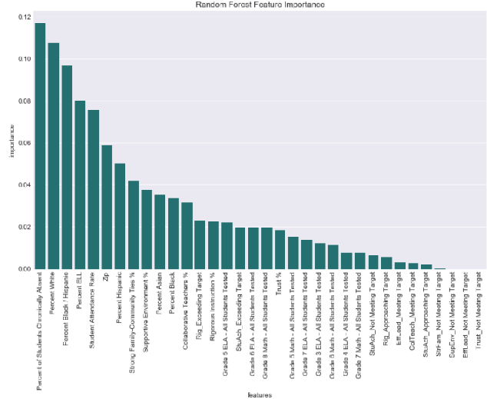
Features Ranked in Importance for Predicting Math Scores

Slide 25
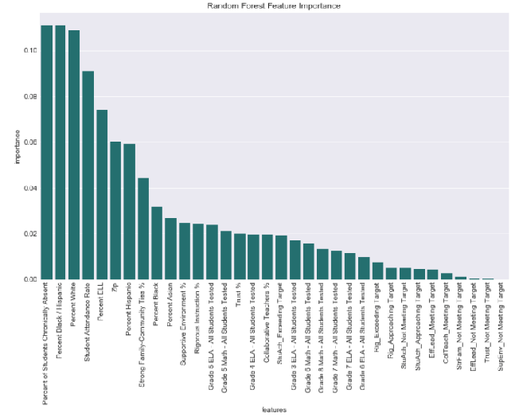
Features Ranked in Importance for ELA

Slide 26
Random forest scores
Test Subject | Parameters | Accuracy (Math) | Overfitting (Math
Math | criterion= 'entropy', max_depth= 38, n_estimators= 34, max_features = 'sqrt' | 85.22% | +/-6%
ELA | criterion= 'gini', max_depth= 17, n_estimators= 44, max_features = 'log2' | 92.06% | +/-3%

Slide 27
Gradient Boosting
Gradient boosting is a supervised learning algorithm uses decision trees.
will perform many times while adjusting the model based on what was learned.
builds one tree at a tree rather than in parallel
commonly a great performer, even when compared with random forest
the training is slow compared to some of the other supervised models
Is prone to overfitting

Slide 28
Gradient boosting score
Test Subject | Parameters | Accuracy (Math) | Overfitting (Math
Math | max_depth= 3, n_estimators= 31, max_features = 'log2’ | 85.03% | +/-7%
ELA | max_depth= 3, n_estimators=37, max_features = 'log2' | 93.2% | +/-2.5%

Slide 29
Best Results
MODEL | Accuracy (Math Scores) | Math Overfit (Math) | ELA Accuracy | ELA Overfit
Random Forest | 85.22% | +/-6% | 92.06% | +/-3 %
logistic regression | 84% | +/-8% | 91.4% | +/-3%
Ridge regression | 84.67% | +/- 8% | 90.76% | +/-3%
Lasso regression | 84.6% | +/- 7% | 90.6% | +/-3%
SVC | 62.4% | +/-15% | 87.2% | +/- 2.5%
Gradient Boosting | 85.03% | +/- 7% | 93.2% | +/-2.5%
KNN | 73% | +/-.3% | 88.62% | +/-2%

Slide 30
Conclusion
I had several key takeaways from this project:
the only bad performer came from SVC for math, KNN math was not great
the simpler models had close accuracy to the more complex models
PCA did not have the better accuracy for any of the models
Random Forest performed for the math test but Gradient boosting was the best for ELA
the other simpler models could be used to reduce complexity if needed.

